Slide 1

ApniNewz
Prepared By
Panchal Aryan : 205170686026
Umang Patel : 205190686051
Shah Kalp : 205170686017
Guided By
Prof. Khushali Vala
Master of Computer Application (Integrated)
Gujarat Technological University

Slide 2
ApniNewz – College News Blog Platform
A centralized digital platform for college-related news and updates.
Developed by Aryan Panchal, Umang Patel, Kalp Shah.
Enrollment Numbers: 205170686026, 205190686051, 205170686017.
Guided by Prof. Khushali Vala at L.J. Institute of Computer Application.
Group No: MCA_10_G30 | Presentation Date: April 2025

Slide 3
Outline
1. Introduction
1.1. Existing System
1.2. Need for the New System
1.3. Objective of the New System
1.4. Problem Definition
1.5. Core Components
1.6. Project Profile
1.7. Assumptions and Constraints
1.8. Advantages and Limitations of the Proposed System
1.9. Proposed Time Line Chart
2. Requirement Determination & Analysis
2.1. Requirement Determination
2.2. Targeted Users

Slide 4
Outline
3. System Design
3.1. Use Case Diagram
3.2. Class Diagram
3.3. Activity Diagram
3.4. Data Dictionary
4. Development
4.1. Coding Standards
4.2. Screenshots
6. Proposed Enhancements
7. Conclusion
8. Bibliography

Slide 5
INTRODUCTION
ApniNewz is a dynamic web application developed using Django and Python to streamline communication within college communities.
It allows students to access academic and event updates, creating a centralized source of truth for all institutional information.
This platform reduces the dependence on outdated methods like notice boards and unorganized WhatsApp groups.
Features like account creation, news posting, rich text formatting, and commenting enhance user interactivity and engagement.

Slide 6
PROBLEM STATEMENT
Most colleges use notice boards, emails, and informal chat groups for news updates, which are inefficient and often lead to missed information.
These traditional methods result in delays, fragmented communication, and low student involvement.
The lack of a unified and interactive system makes it difficult for students to stay informed in real-time.
A need exists for a modern digital platform tailored specifically to a college's internal communication ecosystem.

Slide 7
OBJECTIVES
To provide a centralized and efficient platform for managing all college-related announcements and news.
Ensure faster, more reliable dissemination of updates to the student and faculty community.
Improve student involvement by allowing them to contribute, react, and comment on posts.
Make the platform accessible on mobile and desktop, ensuring all users can stay connected at all times.

Slide 8
CORE FEATURES
Authentication: A secure system for user registration, login, and password reset to manage access and personalization.
Post Management: Allows users to create, edit, delete, and categorize posts to maintain organized content flow.
Commenting: Enables discussion by allowing users to leave comments and respond to others, promoting collaboration.
Likes/Unlikes: Simple interaction tools that let users express appreciation or feedback on news posts.

Slide 9
CORE FEATURES
Profile: Each user has a customizable profile with pictures, bio, and optional social media links.
Responsive UI: Built using Bootstrap, the site is mobile-friendly and functions seamlessly on all screen sizes.
Image & Rich Text Support: CKEditor integration enables formatting and media embedding within posts.

Slide 10
TECHNOLOGY STACK
Frontend: HTML, CSS, and Bootstrap ensure a structured and responsive user interface.
Backend: Django framework in Python handles business logic, routing, and authentication securely.

Slide 11
TECHNOLOGY STACK
Database: Django ORM manages database interactions, with SQLite used.
Tools: Development was carried out using VS Code, GitHub for version control, and Django Admin for backend management.
Libraries: CKEditor was used for rich text editing; potential for Django REST integration for future API support.

Slide 12
SYSTEM DESIGN
Use Case Diagram: Highlights how different user roles interact with the system's features and processes.
Class Diagram: Displays the relationships and structure of main entities like User, News Post, Category, Comment, and Profile.
Activity Diagram: Describes the workflows such as user login, news publishing, and interacting with posts.

Slide 13
SYSTEM DESIGN
Interaction Diagram: Showcases the step-by-step interactions between the User, Website System, and Database during activities like logging in, posting, and commenting.
Data Dictionary: Defines the database schema, listing all fields and constraints for every major model.

Slide 14
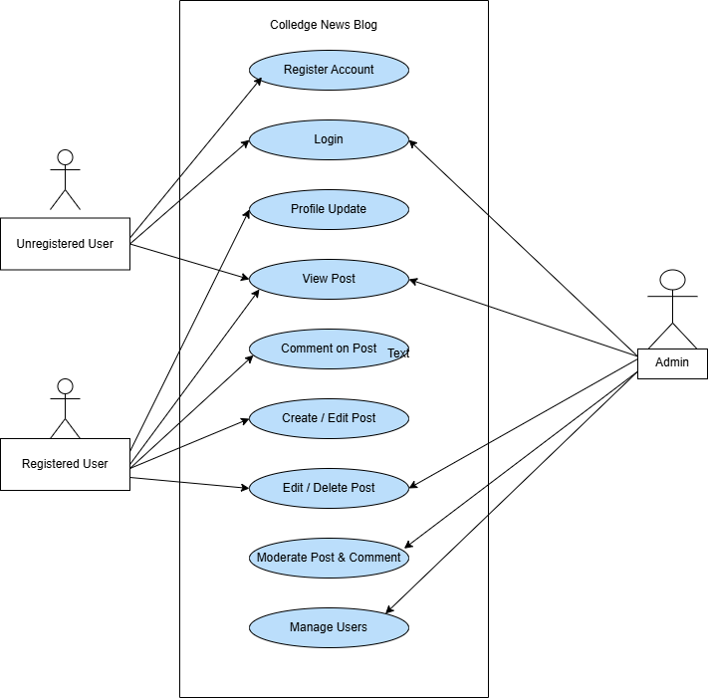
Use Case Diagram: Highlights how different user roles interact with the system's features and processes.

Slide 15
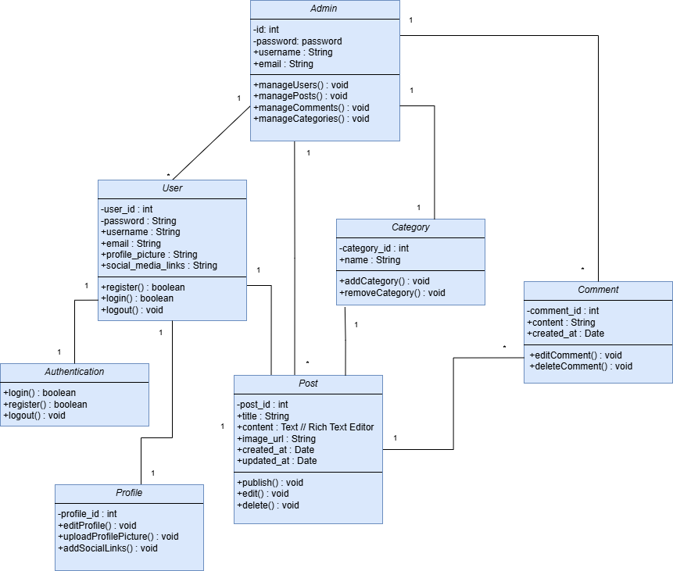
Class Diagram: Displays the relationships and structure of main entities like User, News Post, Category, Comment, and Profile.

Slide 16
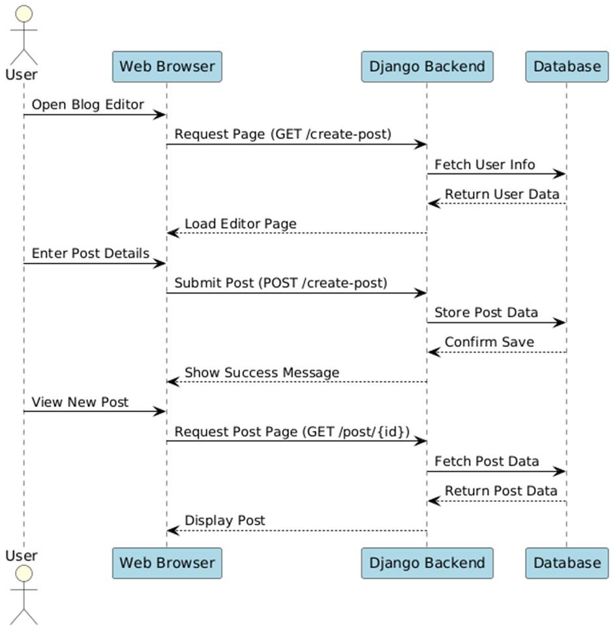
Interaction Diagram: Showcases the step-by-step interactions between the User, Website System, and Database during activities like logging in, posting, and commenting.

Slide 17
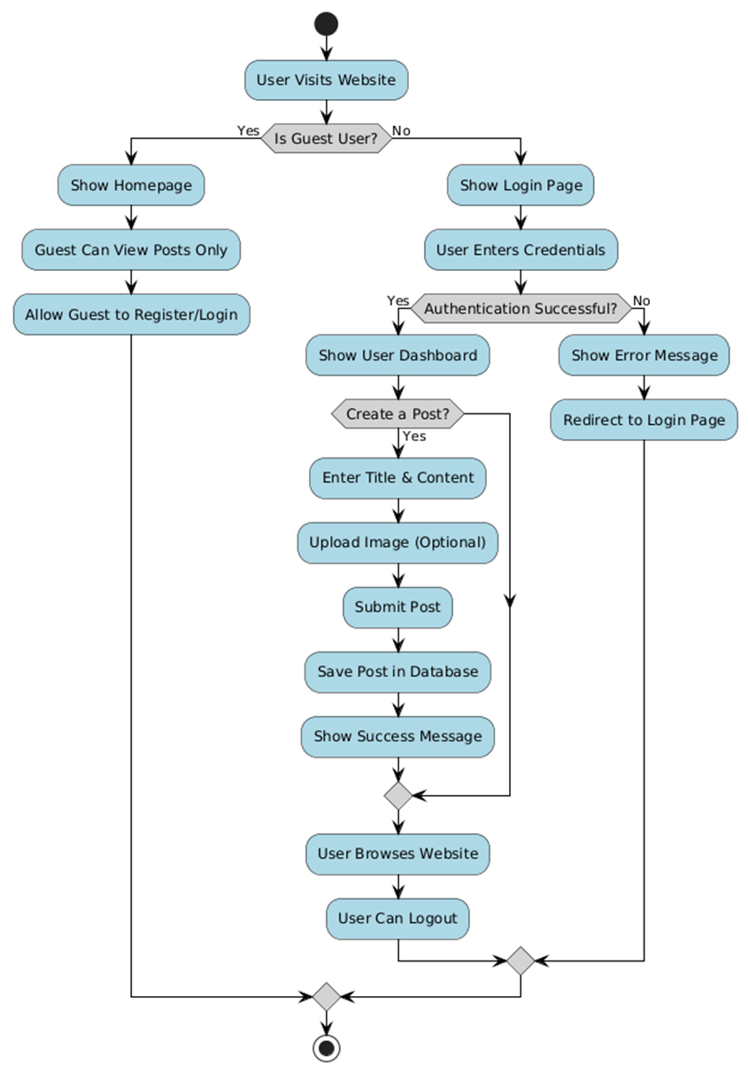
Activity Diagram: Describes the workflows such as user login, news publishing, and interacting with posts.

Slide 18
DATA DICTIONARY
Table Name: User
Table Description: Stores essential user information including identity, contact details, login credentials, and permissions for system access.
Sr. no | Name | Datatype | Constraint | Description
1 | ID | Integer | Primary Key | To store the User ID
2 | First_name | Varchar (100) | Not Null | To store the first name
3 | Last_name | Varchar(100) | Not Null | To store the last name
4 | Username | Varchar(50) | Unique, Not Null | To store the username
5 | Email | Varchar | Unique, Not Null | To store the email address
6 | Phone | Varchar(10) | Nullable | To store the phone number
7 | Profile_image | Varchar | Nullable | To store the profile image path
8 | Enrollment_number | Varchar(12) | Unique, Not Null | To store the enrollment number
9 | Password | Varchar(128) | Not Null | To store the user password
10 | Confirm_password | Varchar(128) | Not Null | To store the confirmed password
11 | User_permissions | ManyToMany | Nullable | To store user permissions

Slide 19
Table Name: Category
Table Description: Contains predefined news categories used to organize and filter blog posts within the platform.
Sr No. | Field Name | Data Type | Constraints | Description
1 | Category_Name | CharField(100) | Required | Category name

Slide 20
Table Name: News
Table Description: Stores news articles published by users, including titles, content, category association, media files, authorship, publication status, and engagement details.
Sr No. | Field Name | Data Type | Constraints | Description
1 | Title | CharField(255) | Required | News article title
2 | Sub_title | CharField(255) | Required | News article subtitle
3 | Category | ForeignKey(Category) | Required | Category of the news
4 | Author | CharField(50) | Required | Author of the news
5 | Content | RichTextField | Optional | Main content of the news
6 | Status | CharField(255) | Required | Status of the news (PUBLISH/DRAFT)
7 | News_image | ImageField | Required | Image associated with the news
8 | Likes | ManyToManyField(User) | Optional | Users who liked the news
9 | Created | DateTimeField | Auto Now Add | Timestamp when news was created
10 | Updated | DateTimeField | Auto Now | Timestamp when news was last updated

Slide 21
Table Name: Profile
Table Description: Extends user information with additional personal and demographic details such as bio, gender, location, and profile images.
Sr No. | Field Name | Data Type | Constraints | Description
1 | User | OneToOneField(User) | Required | User associated with the profile
2 | Phone | CharField(15) | Optional | User's phone number
3 | Gender | CharField(1) | Required | User's gender (M/F/O)
4 | Enrollment_number | CharField(12) | Unique, Required | User's enrollment number
5 | Profile_image | ImageField | Optional | User's profile picture
6 | Bio | TextField | Optional | User's bio
7 | Location | CharField(30) | Optional | User's location
8 | Created | DateTimeField | Auto Now Add | Timestamp when profile was created
9 | Updated | DateTimeField | Auto Now | Timestamp when profile was last updated

Slide 22
Table Name: Comments
Table Description: Maintains user-generated comments associated with news posts, enabling interaction and discussion within the platform.
Sr No. | Field Name | Data Type | Constraints | Description
1 | News | ForeignKey(News) | Required | News article associated with the comment
2 | User | ForeignKey(User) | Required | User who posted the comment
3 | Comment | TextField | Required | Comment text
4 | Created | DateTimeField | Auto Now Add | Timestamp when comment was created
5 | Updated | DateTimeField | Auto Now | Timestamp when comment was updated

Slide 23
Table Name: Contact
Table Description: Captures messages submitted through the contact form, including sender’s name, email, subject, and message content for admin review.
Sr No. | Field Name | Data Type | Constraints | Description
1 | Name | CharField(100) | Required | Name of the person contacting
2 | Email | EmailField | Required | Contact email
3 | Subject | CharField(200) | Required | Subject of the message
4 | Message | TextField | Required | Message content
5 | Created_at | DateTimeField | Auto Now Add | Timestamp when message was created

Slide 24
Table Name: Login
Table Description: Manages login credentials specifically focusing on email and password for secure authentication of users.
Sr No. | Field Name | Data Type | Constraints | Description
1 | Email | EmailField | Unique, Required | User's email address
2 | Password | CharField(128) | Required | User's password

Slide 25
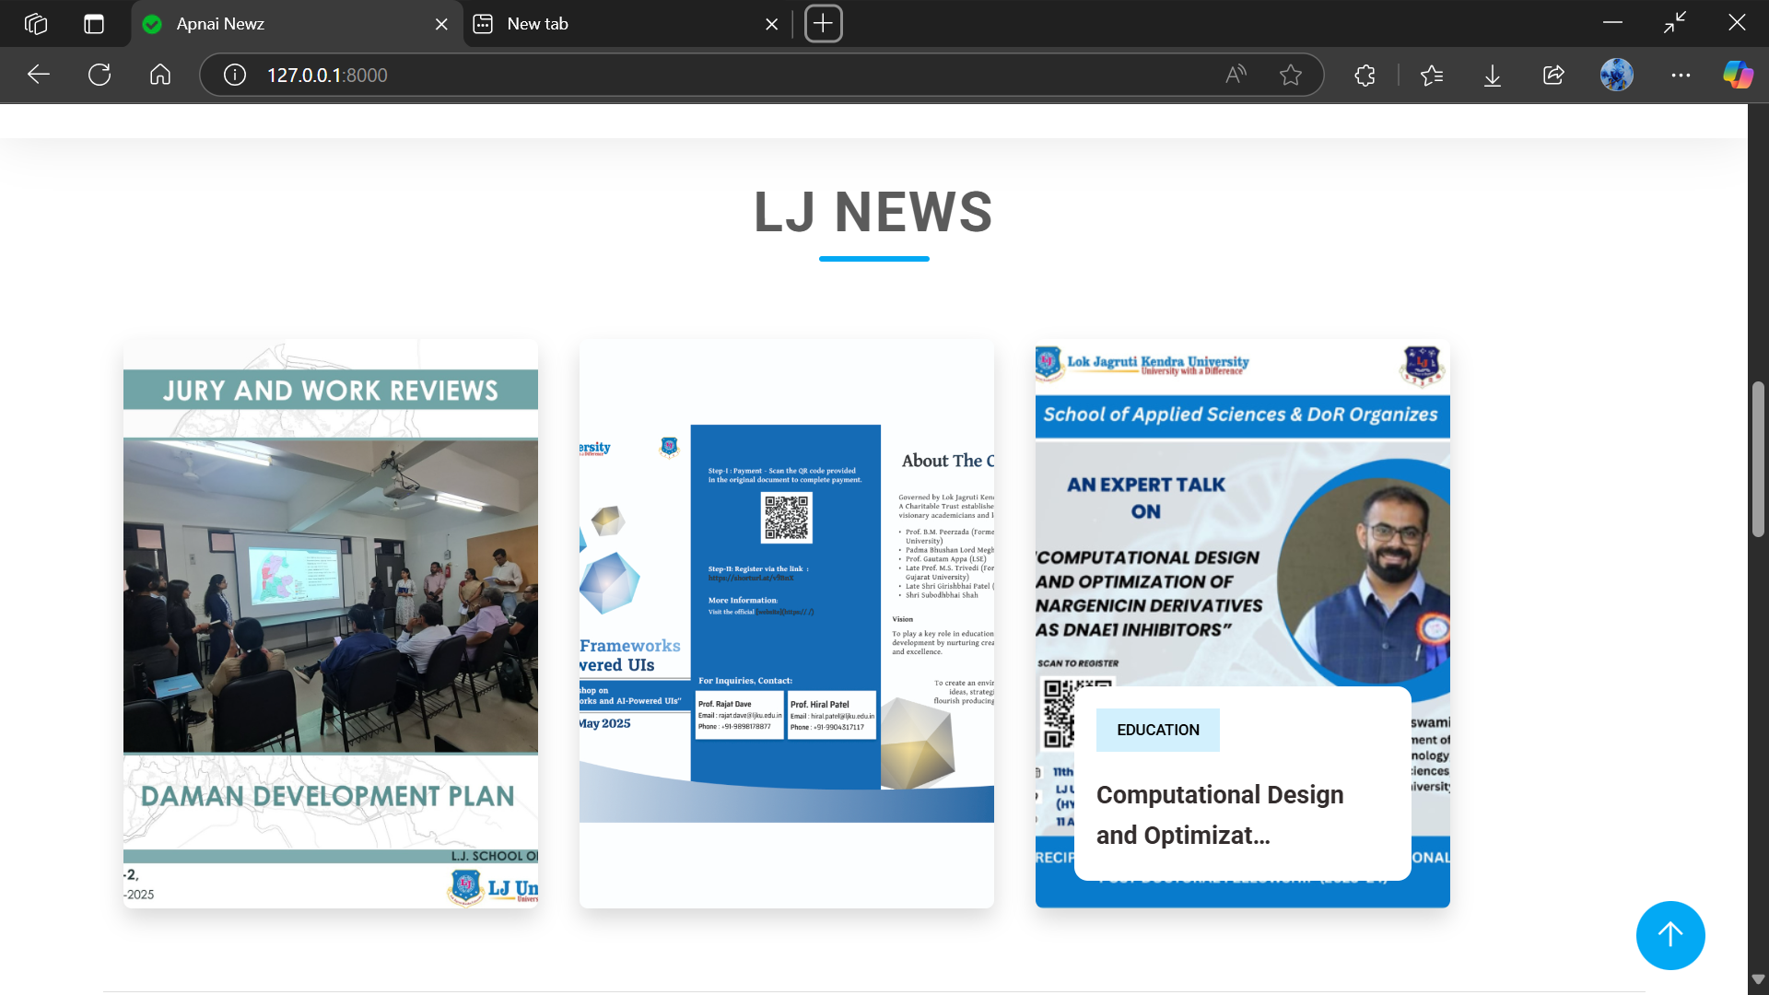
Screenshots
Home Page

Slide 26
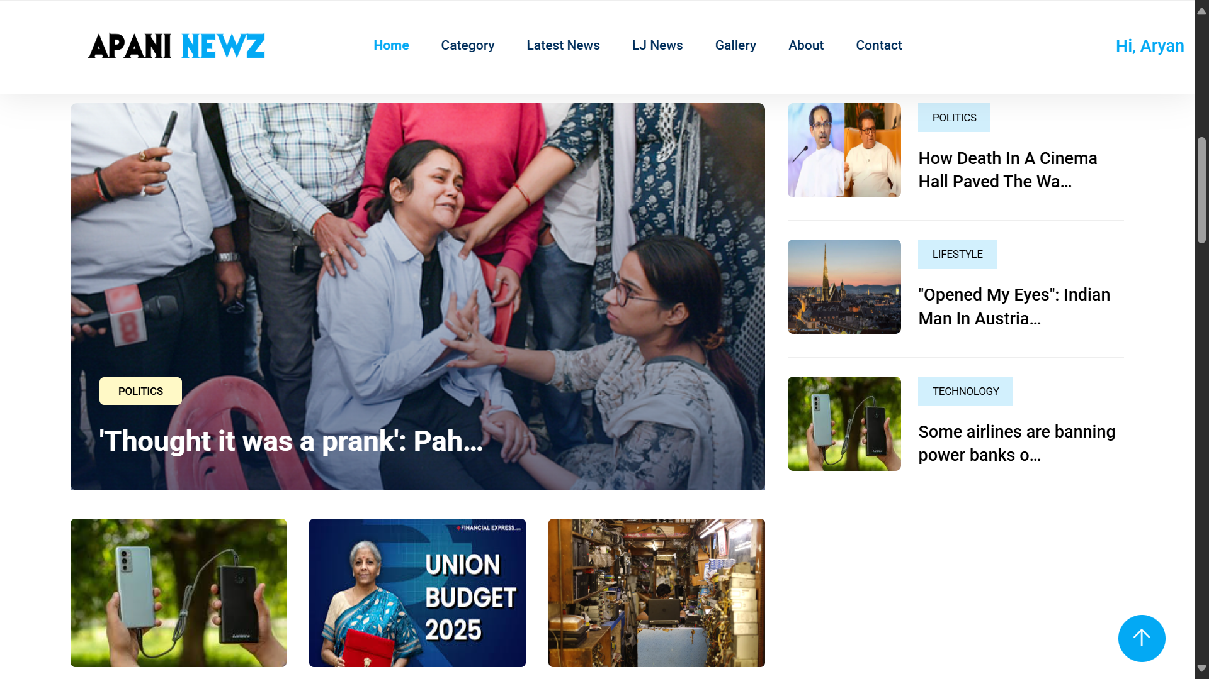
News

Slide 27
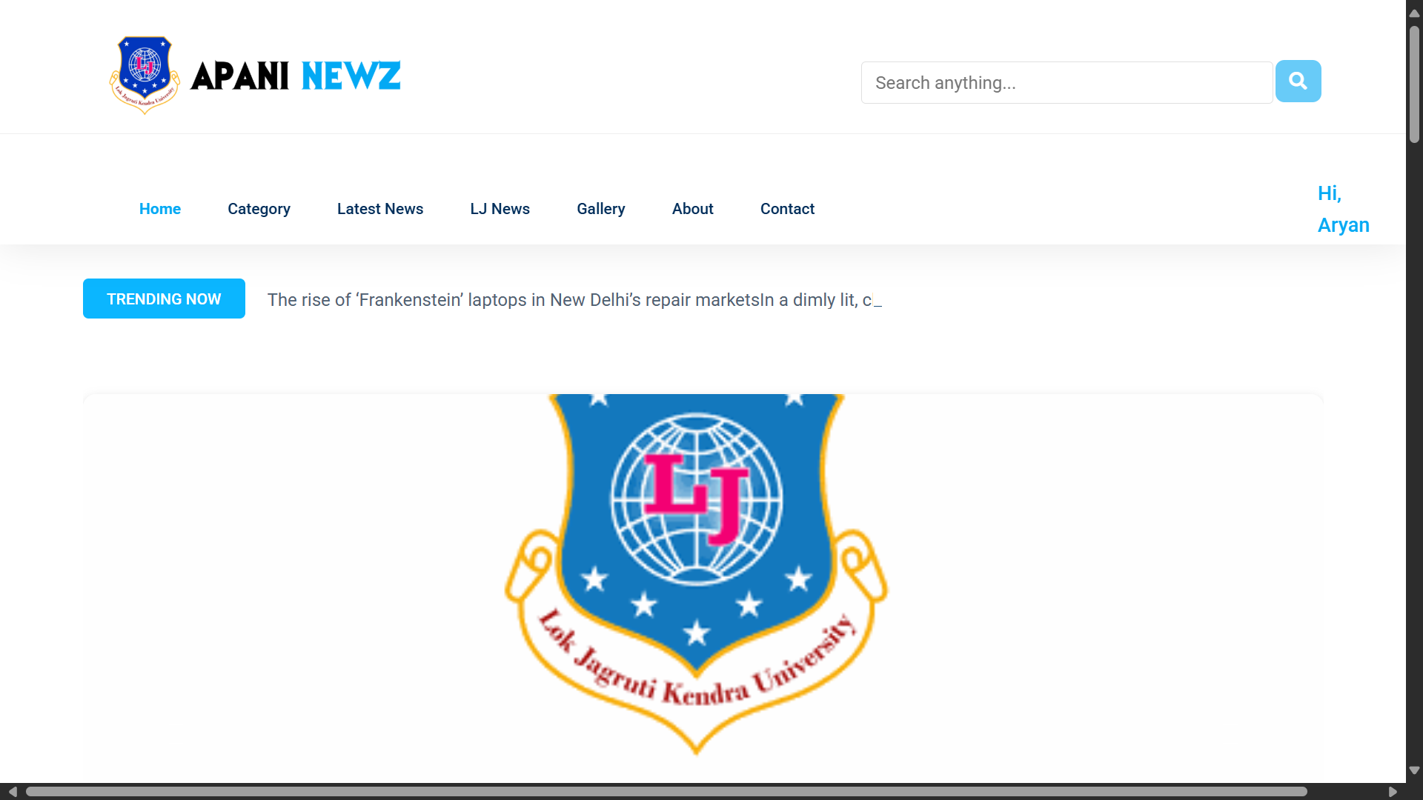
Banner

Slide 28
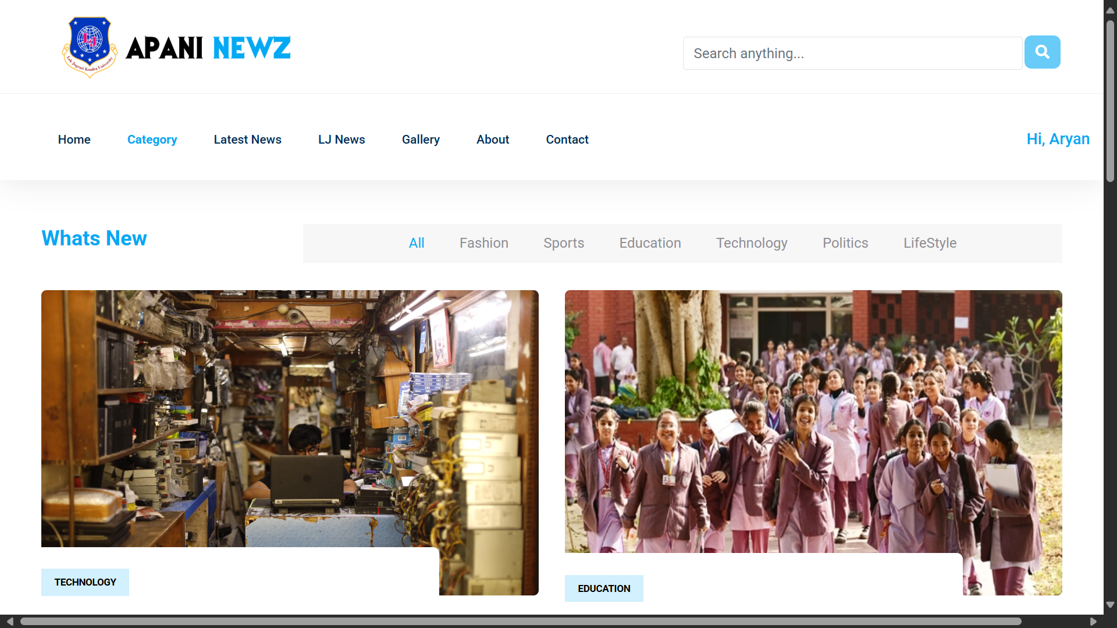
Category

Slide 29
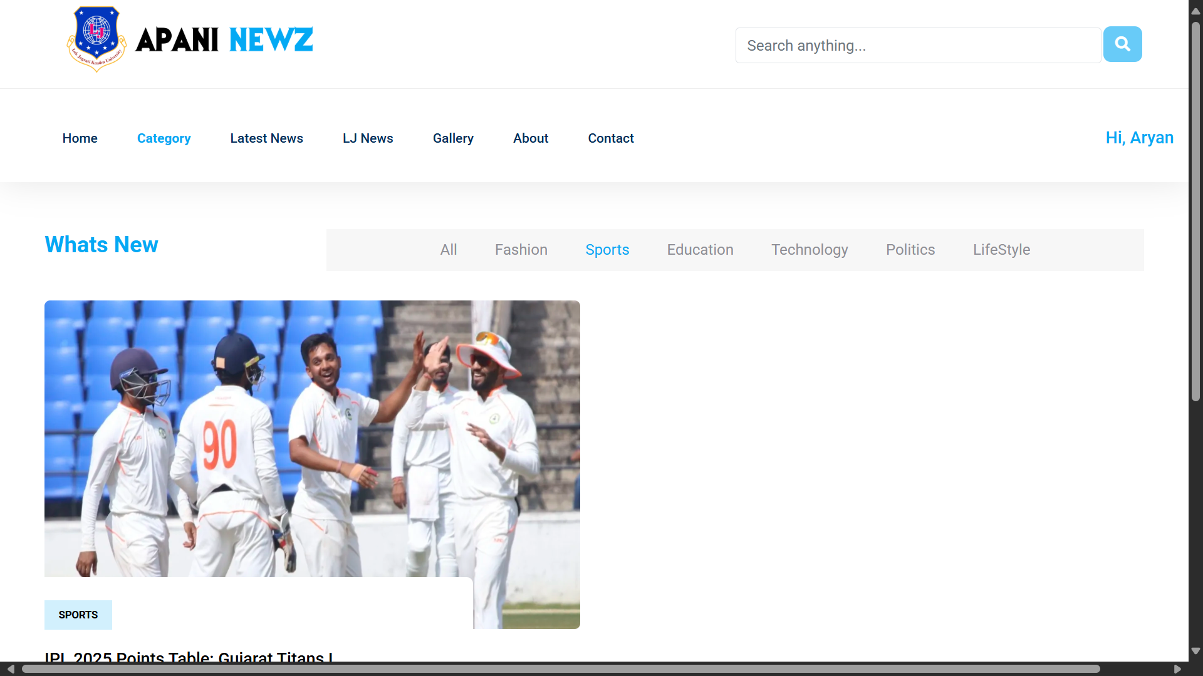
Category : Sports

Slide 30
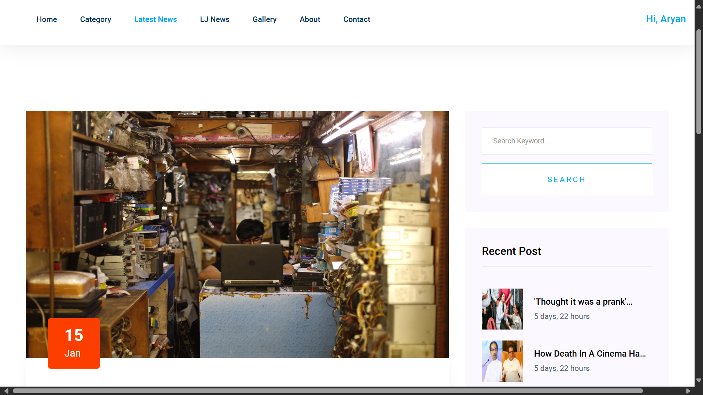
Latest News

Slide 31
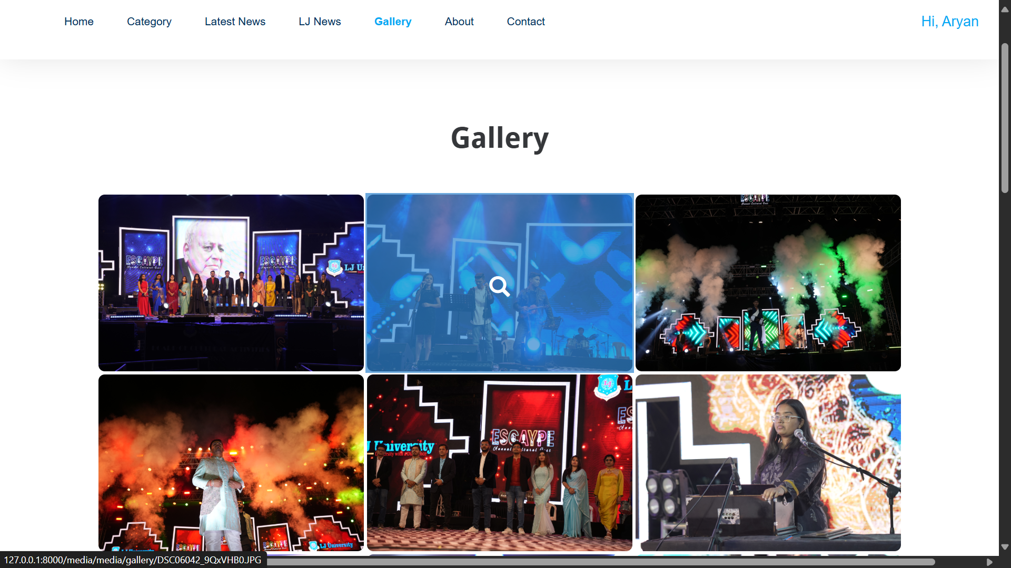
Gallery
News

Slide 32
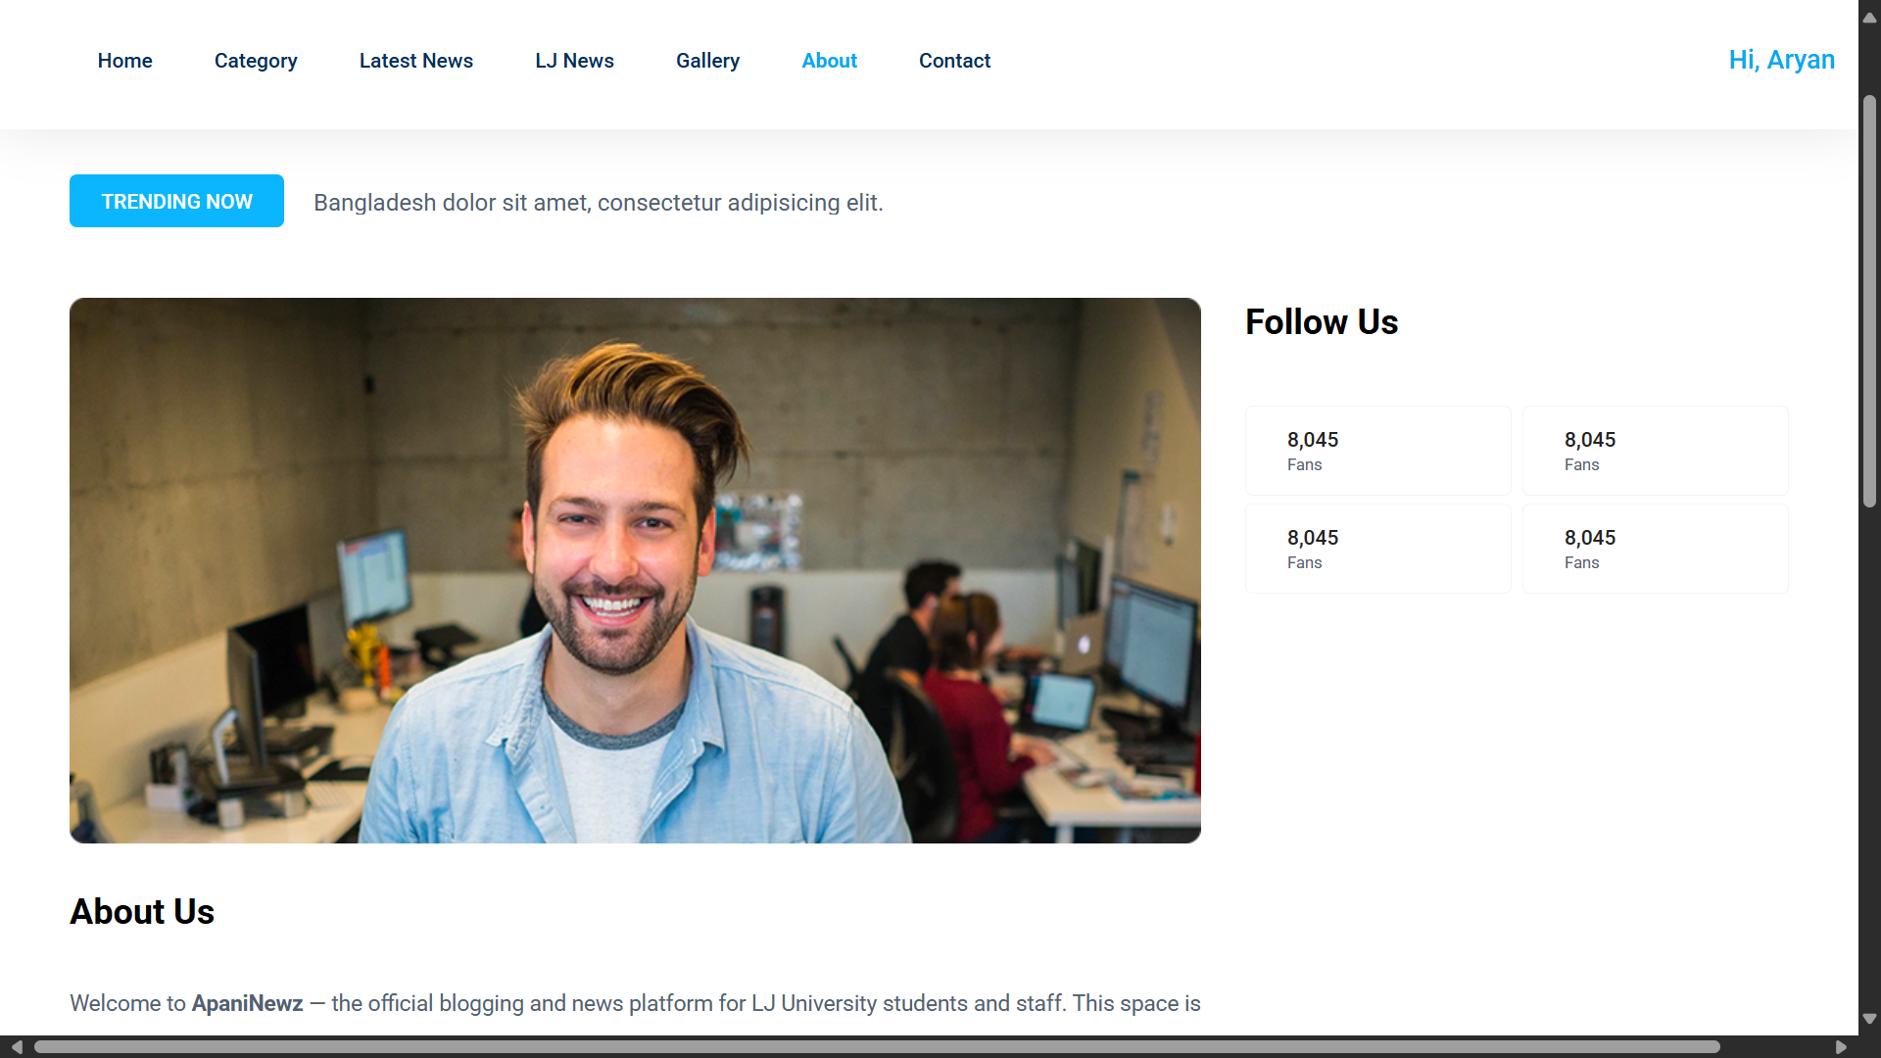
About Us Page

Slide 33
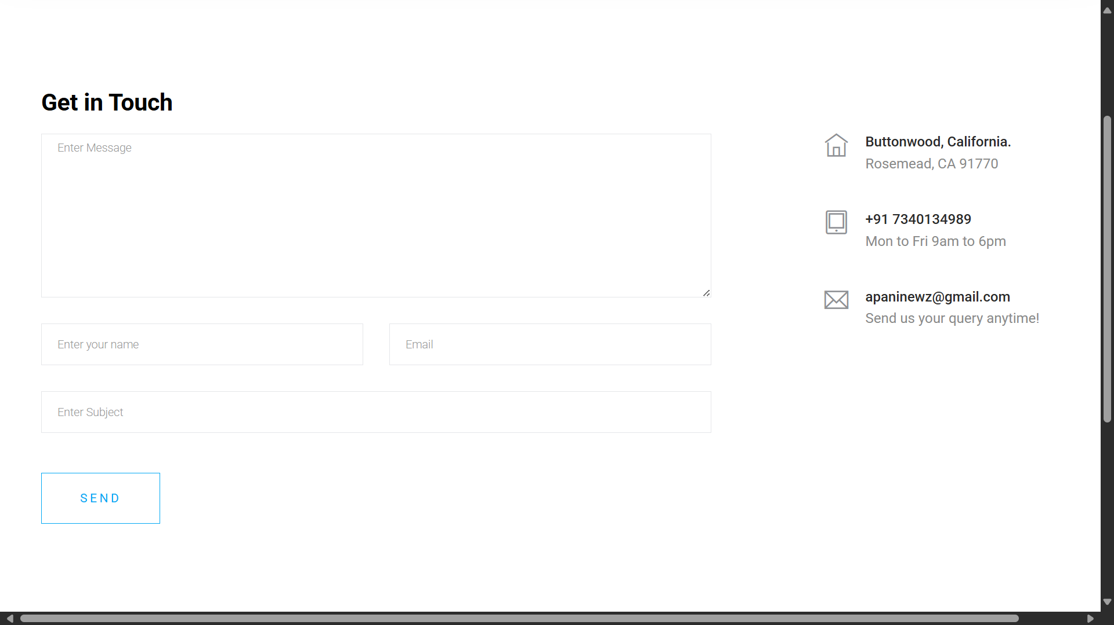
Contact us

Slide 34
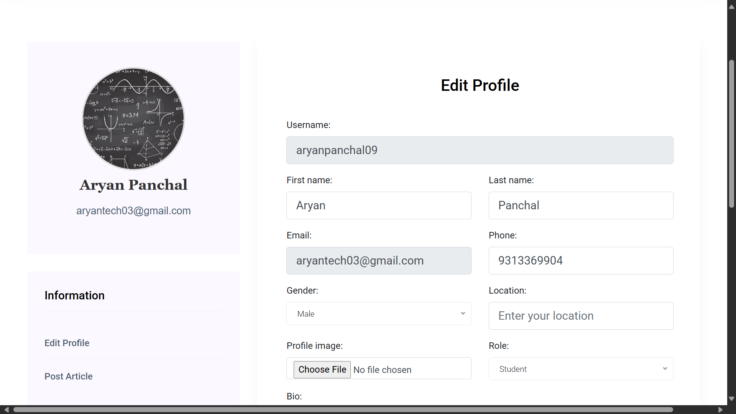
Profile Page

Slide 35
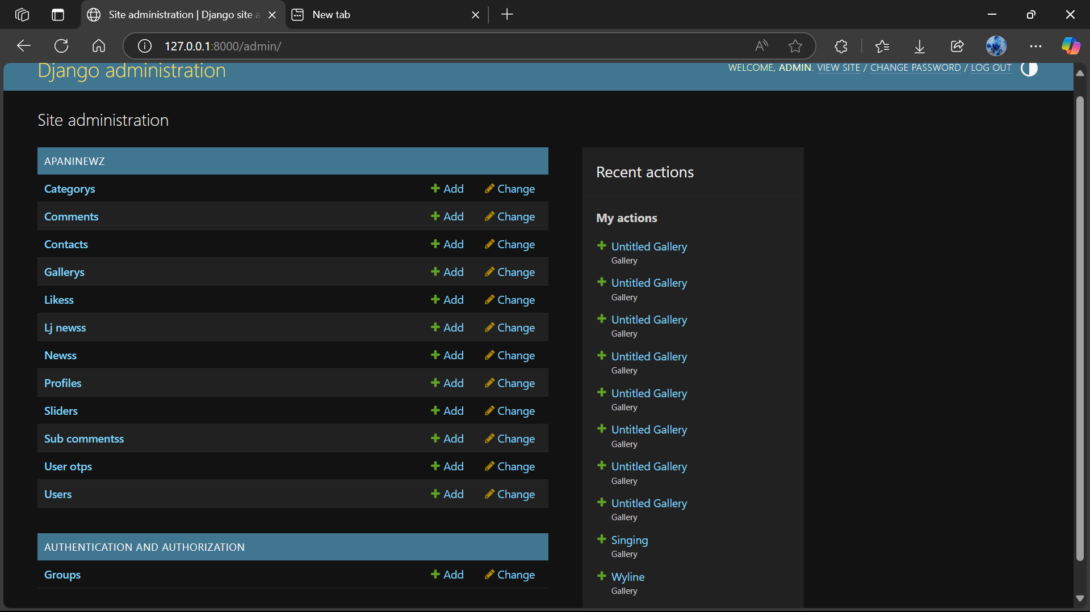
Admin

Slide 36
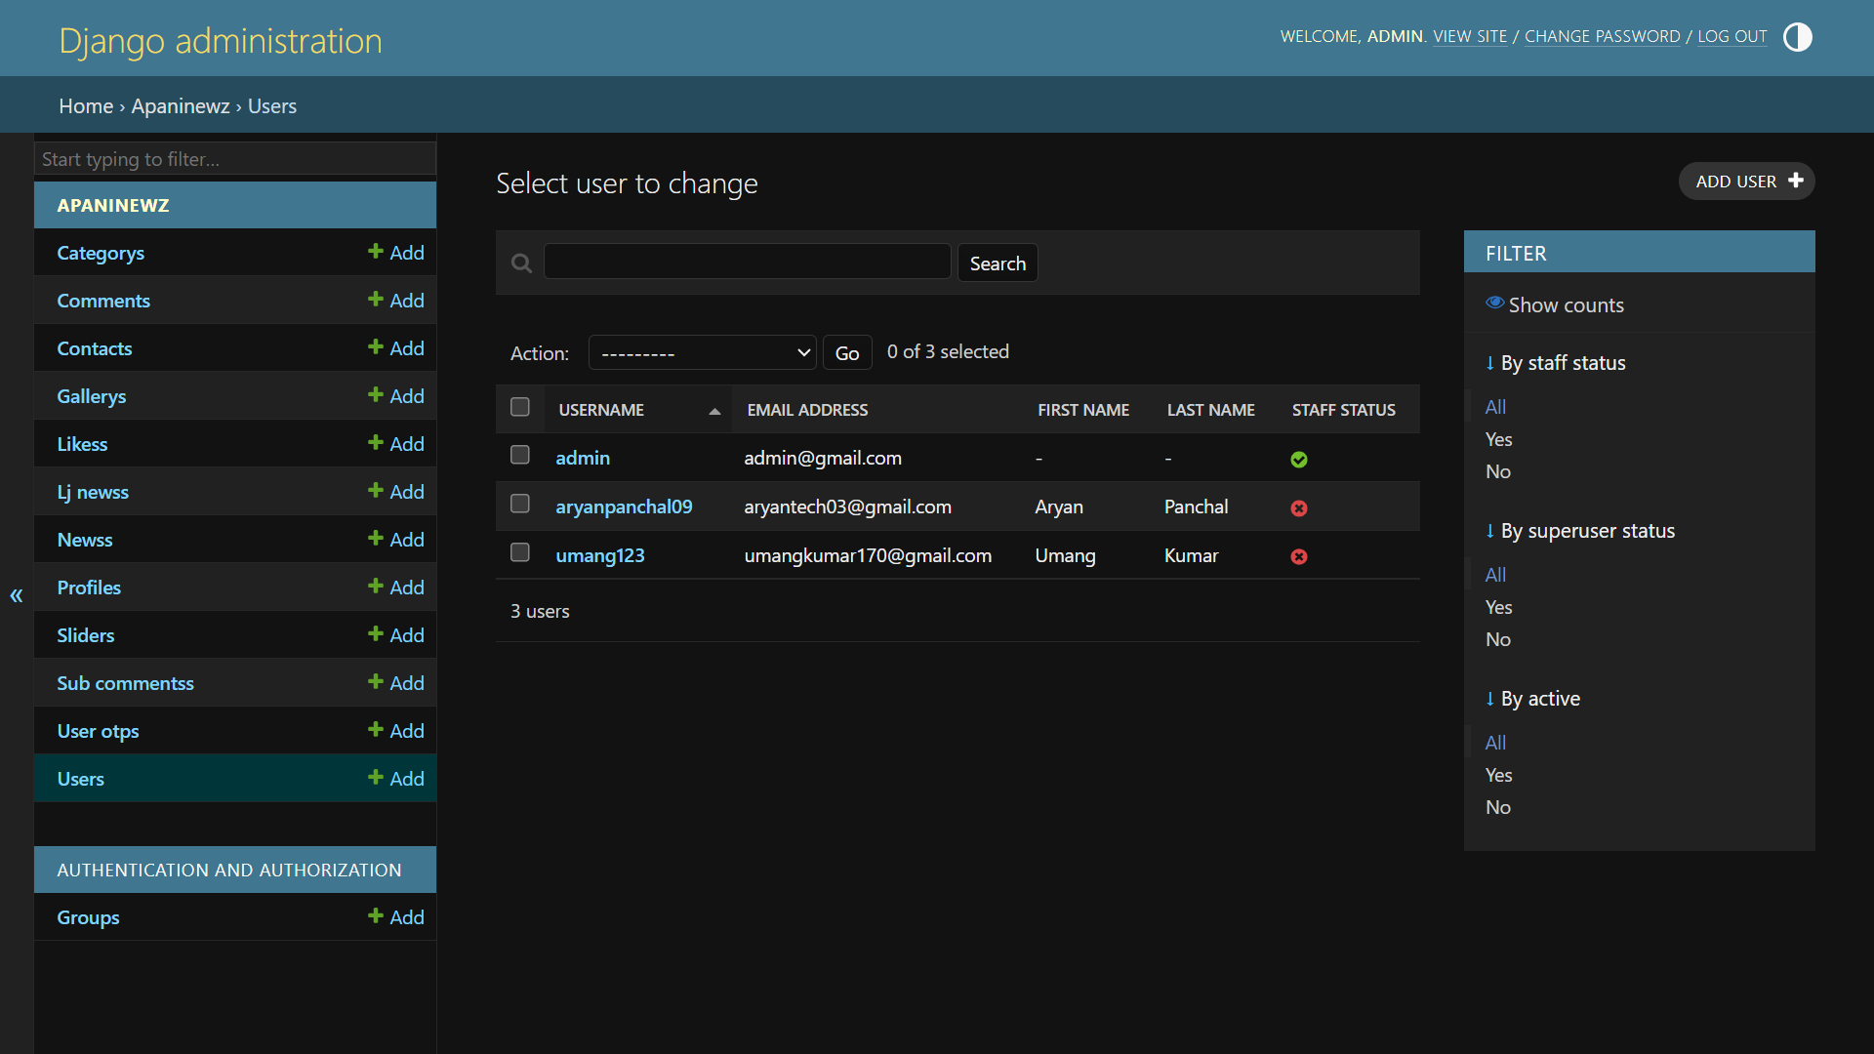
News

Slide 37
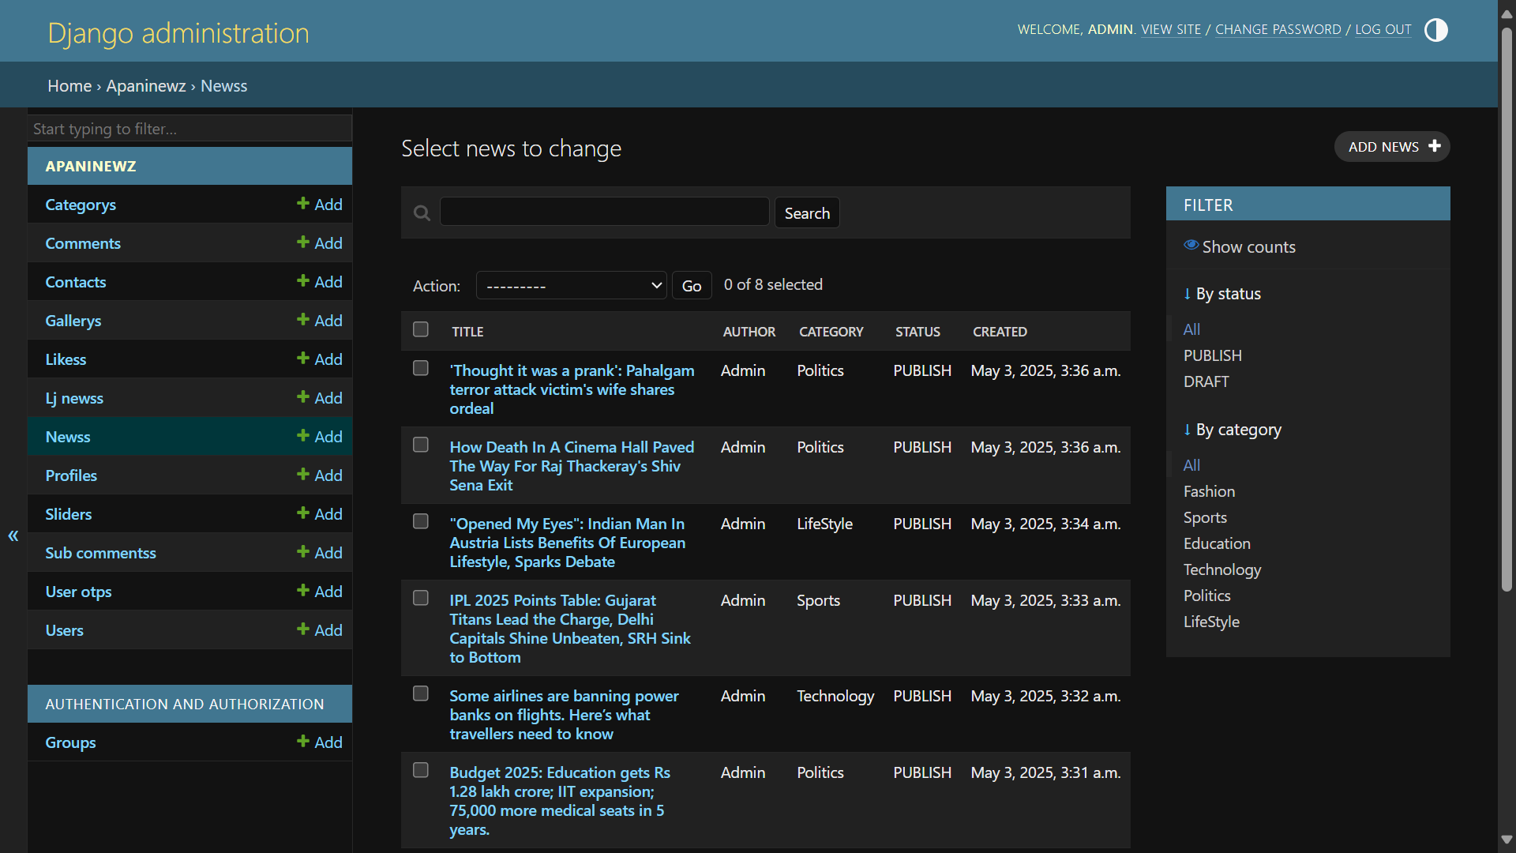

Slide 38
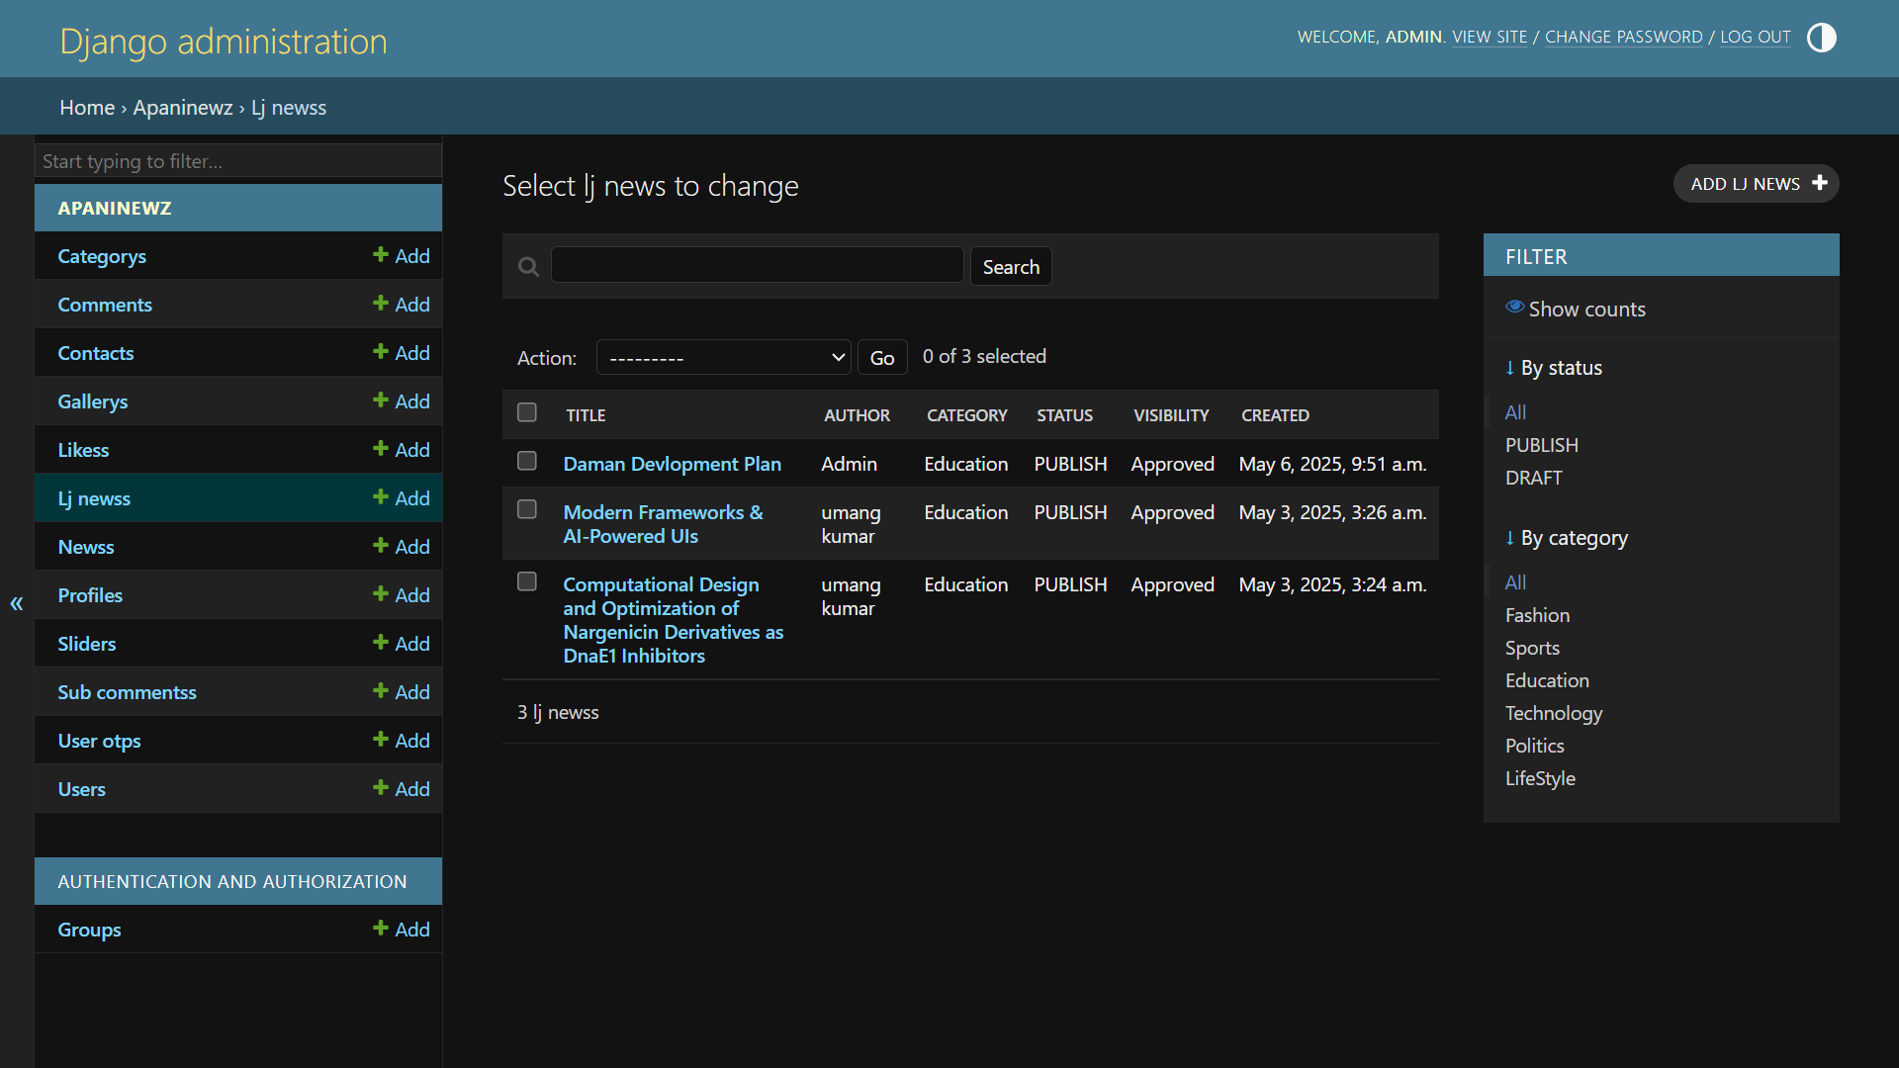

Slide 39
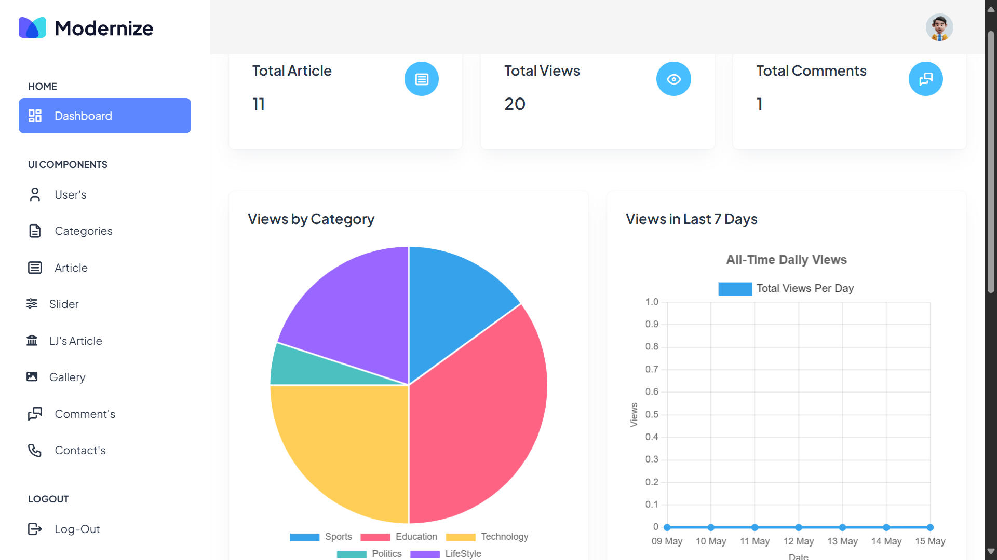
Chart.js UI Library

Slide 40
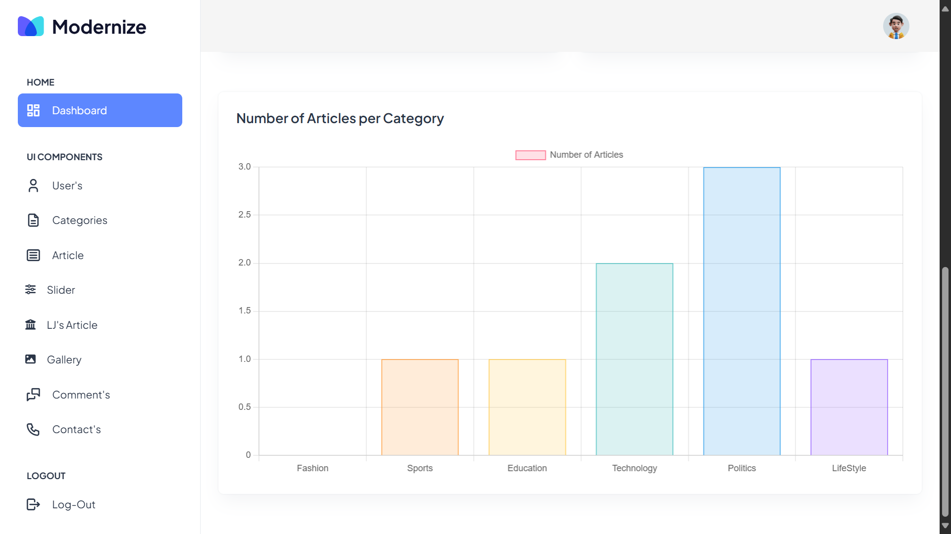

Slide 41
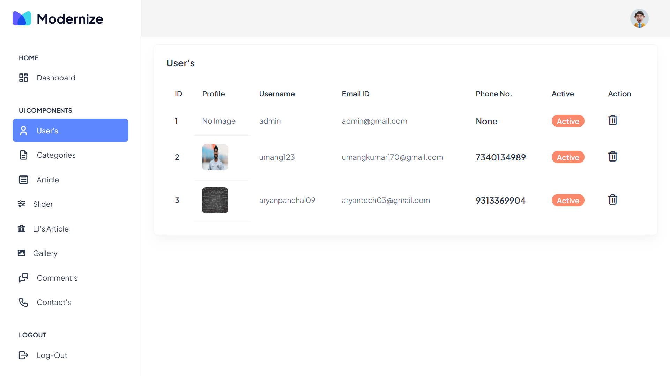

Slide 42
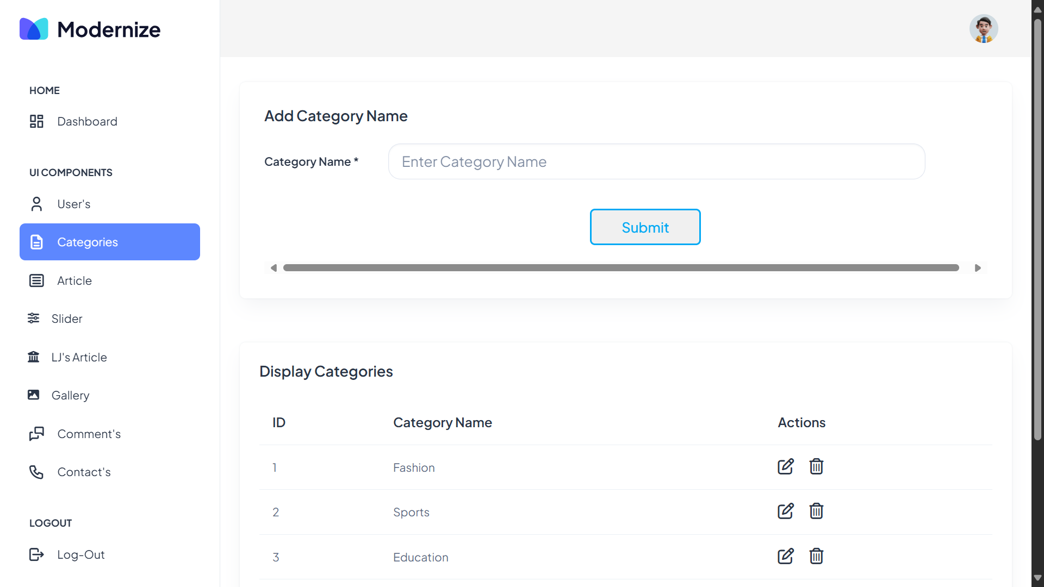

Slide 43
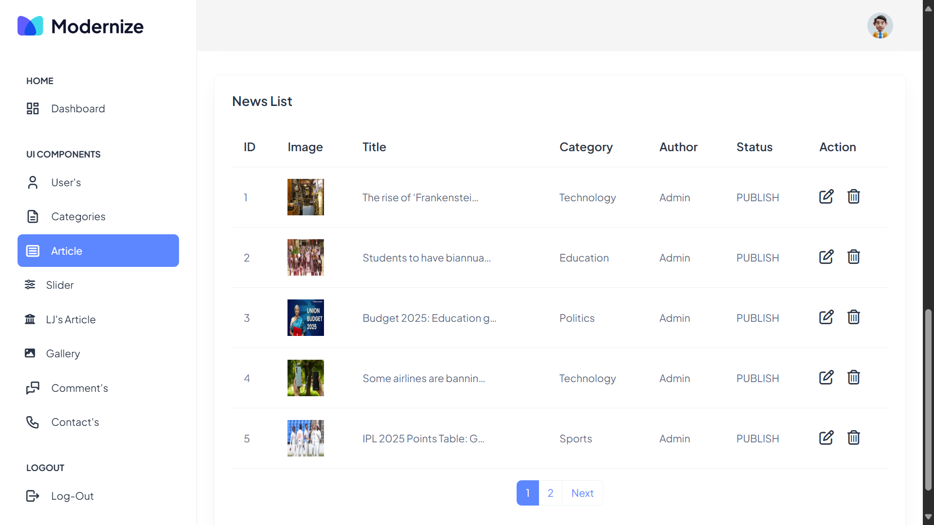

Slide 44
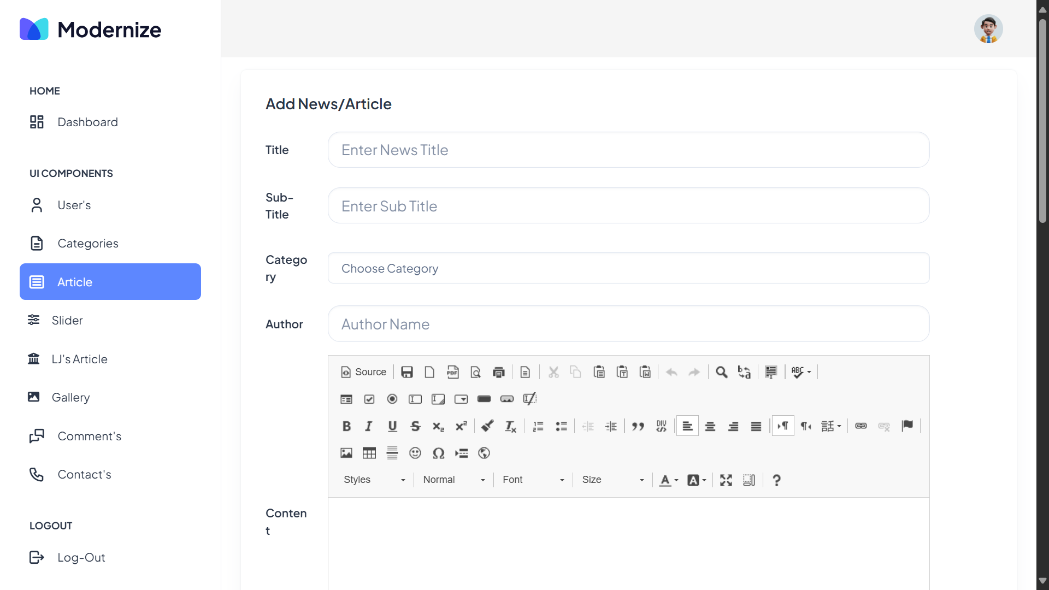

Slide 45
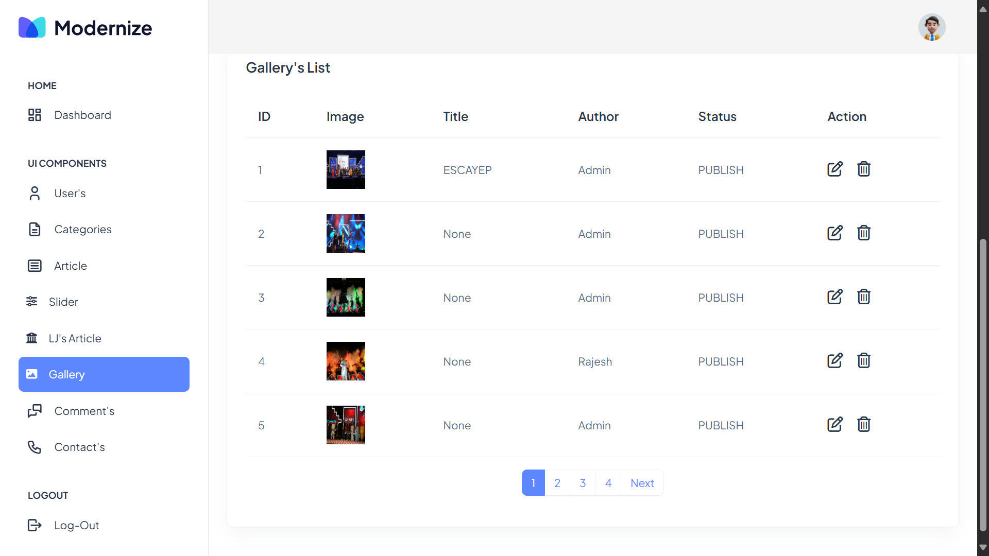

Slide 46
TESTING HIGHLIGHTS
Comprehensive manual testing was carried out to ensure the reliability of major modules.
Login Module: Successfully tested for valid, invalid, and edge-case credential inputs.
Registration: Checked for email uniqueness, password matching, and required field validation.

Slide 47
TESTING HIGHLIGHTS
Comment System: Verified for comment creation, edit/delete functionality, and error handling.
Payment (Optional): Included checkout and card validation; tested both success and failure cases.
Overall, the system passed most tests with minor issues resolved promptly during development.

Slide 48
PROPOSED ENHANCEMENTS
Introduction of multilingual capabilities to make the platform more inclusive for diverse users.
Implementation of a powerful search system with filters by tags, categories, and authors.
Expanded user roles to include content editors, moderators, and department-specific admins.

Slide 49
PROPOSED ENHANCEMENTS
Real-time notifications to alert users about new posts, comments, or likes.
Admin analytics dashboard to track user activity, popular posts, and platform usage metrics.
Integration of a college calendar for events, and support for uploading video content.
Development of an API layer to connect with external tools or mobile applications.

Slide 50
Conclusion
ApniNewz successfully bridges the gap in campus communication by providing a feature-rich and user-friendly web platform.
It fulfills its goal of enhancing student-faculty interaction and offering a structured place for news sharing.
With strong foundational features and an Agile-based development model, it is scalable for future use and innovation.
The project also served as an excellent opportunity to apply and expand full-stack development skills using Django.

Slide 51
BIBLIOGRAPHY
BOOKS
Django for Beginners by William S. Vincent
Python Crash Course by Eric Matthes
Clean Code: A Handbook of Agile Software Craftsmanship by Robert C. Martin
Two Scoops of Django 3.x: Best Practices for the Django Web Framework by Daniel Roy Greenfeld and Audrey Roy Greenfeld

Slide 52
BIBLIOGRAPHY
ONLINE RESOURCES
Codemy.com YouTube Playlist on Django 🔗 https://www.youtube.com/c/Codemycom
Django Documentation 🔗 https://docs.djangoproject.com/en/stable/
W3Schools Bootstrap Tutorial 🔗 https://www.w3schools.com/bootstrap4/
Real Python 🔗 https://realpython.com/

Slide 53
BIBLIOGRAPHY
RESEARCH PAPERS
"A Study on the Agile Software Development Process" – Journal of Software Engineering, 2021
"Web Application Security: A Survey of Best Practices" – International Journal of Computer Science, 2020
"A Comparative Study of Web Frameworks for Rapid Application Development" – IJACSA, 2021

Slide 54
BIBLIOGRAPHY
TOOLS
GitHub 🔗 https://github.com/
Bootstrap 🔗 https://getbootstrap.com/
Django Framework 🔗 https://www.djangoproject.com/
OWASP Web Security Guidelines 🔗 https://owasp.org/www-project-top-ten/
OTHERS
Stack Overflow (For troubleshooting and community discussions) 🔗 https://stackoverflow.com/

